Slide 1
Patient- 3.0
Sean G. Boynes, DMD, MS
Director of Interprofessional Practice

Slide 2
The Growth of Transparency

Slide 3
“A funny thing is happening at the intersection of culture and health - spilling over into politics and policy — a vigorous demand for transparency in health care.”
JOEL WHITE
President of the Council for Affordable Health Coverage

Slide 4
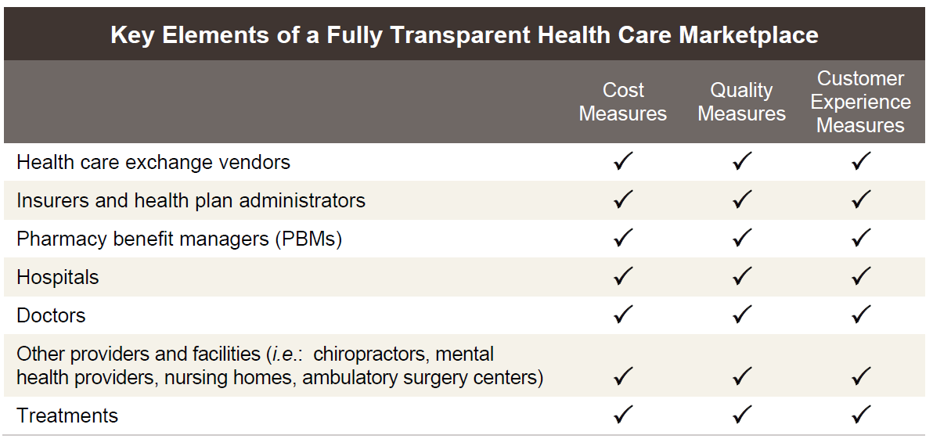
http://www.americanhealthpolicy.org/Content/documents/resources/Transparency%20Study%201%20-%20The%20Need%20for%20Health%20Care%20Transparency.pdf
Notes:
Health care, like any other product or service, can and should be measured based on
relative cost and quality. The results, in turn may be shared with those who consume and
purchase health care to create a more competitive and accountable marketplace. Measures of
relative cost and quality can be applied throughout the supply chain. In a fully transparent
market, measures that disclose the relative cost, quality and customer experience for all
elements of the health care supply chain would be publicly available. The following table
illustrates what full transparency what those key elements are.

Slide 5
Improved transparency can directly benefit the system/consumers:
Inform their public policy agenda:
Access to information on relative health care costs and quality is essential to supporting employers as they develop their public policy agenda. For example, employers can assess if market based reforms are having the desired effect to reduce costs and improve quality.
Support improved benefit design strategies:
Without access to information on cost and quality, informed beneficiaries enrolled in consumer driven plans cannot access the information they need.
Stimulate competition based on value:
With access to information on the relative performance of health plans, organizations, systems, and care teams as well as the rest of the health care supply chain, employers/government/consumers will be much better equipped to choose plans and providers who truly deliver the best value.
Advance provider payment reform:
It is widely accepted that one of the greatest problems affecting the U.S. health care system is the prevalence of fee for service payment systems that reward the volume of services instead of outcomes.
http://www.americanhealthpolicy.org/Content/documents/resources/Transparency%20Study%201%20-%20The%20Need%20for%20Health%20Care%20Transparency.pdf

Slide 6
Dental Patient Growth and Financial Viability
Growth and financial viability is underpinned by the need to provide consumers with what they want:
Price and operational transparency
Greater flexibility in opening hours
Information technology and digital services

Slide 7
Affordability
So even as policy makers crow that health costs are growing at their slowest rate in years:
Consumers and businesses are saying that affordability of health coverage is the number-one challenge they face.
Health plans have responded with insurance designs that incentivize consumers to use high-value in-network providers — a strategy that is helping to create awareness and price sensitivity among the “silent majority” of relatively healthy consumers.
Many plans, meanwhile, have adopted “narrow networks” that directly exclude low-value providers.
Notes:
Significantly, both strategies depend on consumer choice. A backlash has emerged against narrow networks as a rationing tool. The trade-off between unfettered access and cost is a real one, no doubt, but the evidence has not shown access to care has been harmed. The development and wider use of provider cost and performance measures along with consumer information on the composition and performance of health plan networks will help on both fronts, access and costs.

Slide 9
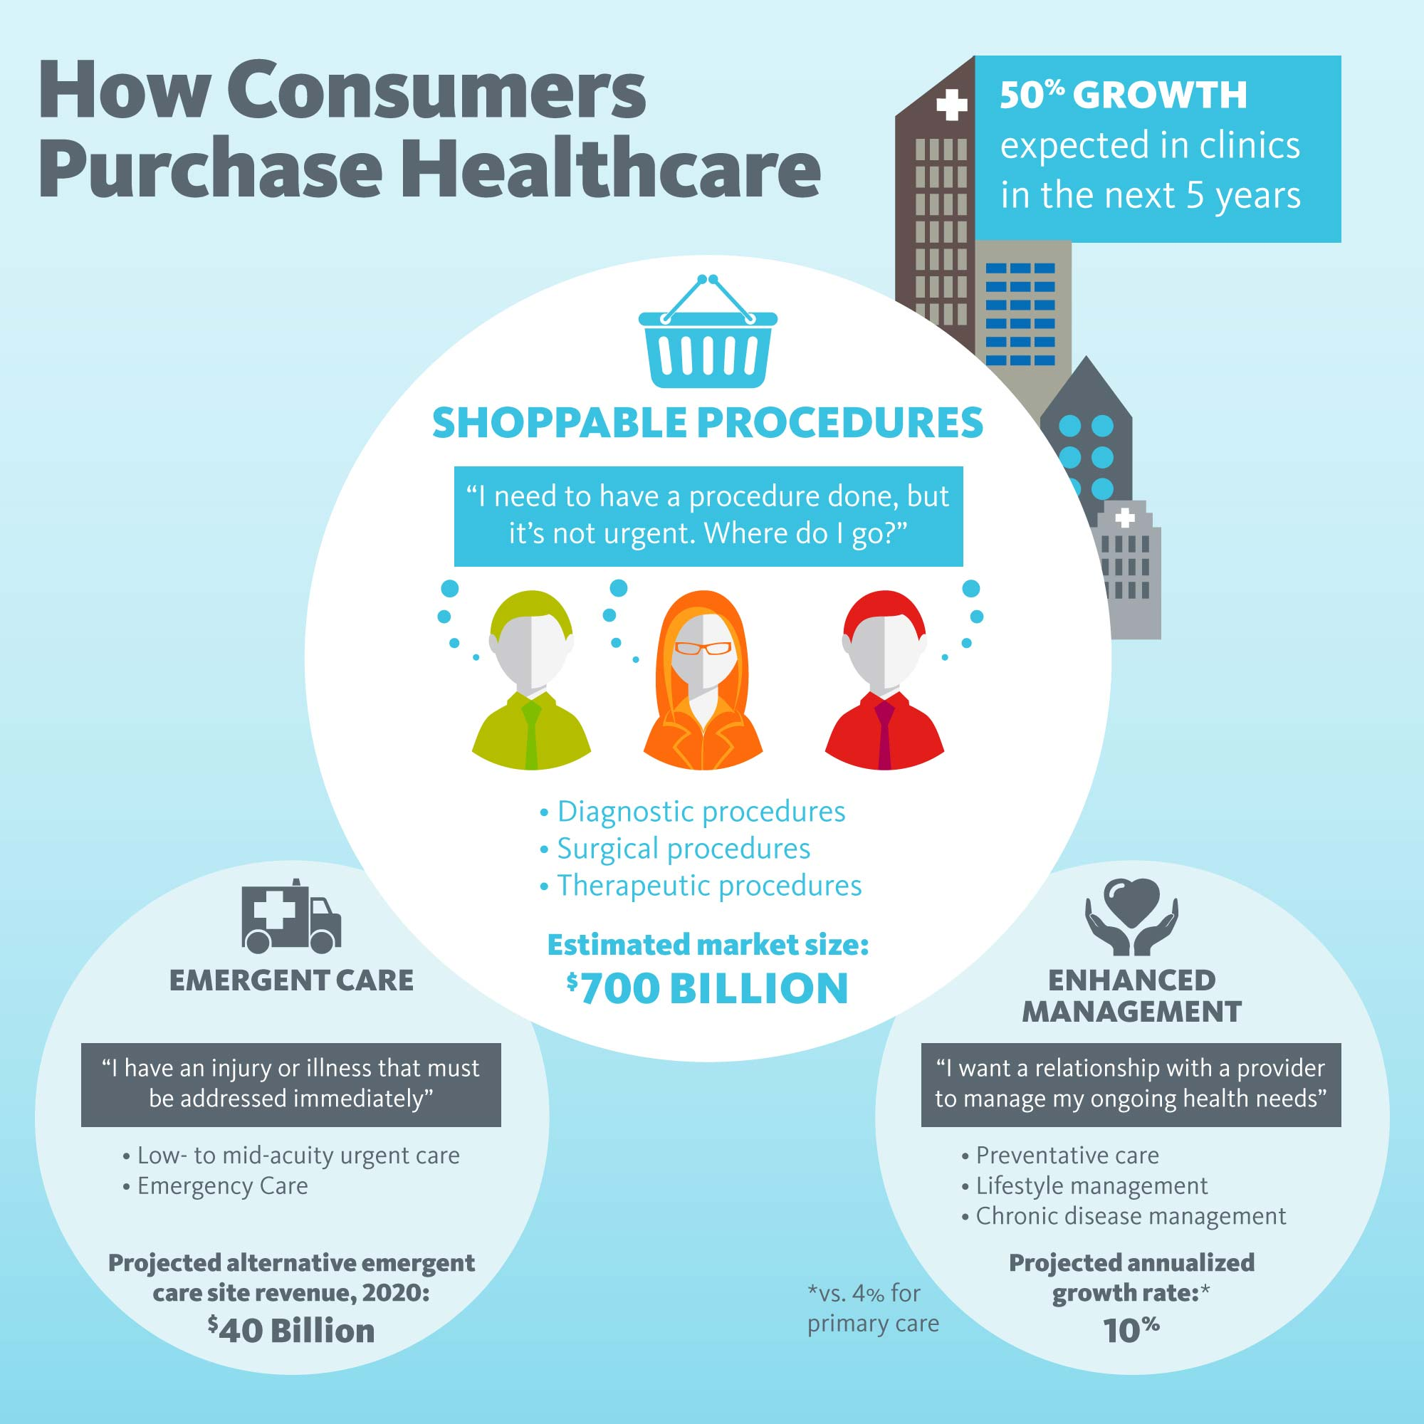

Slide 10
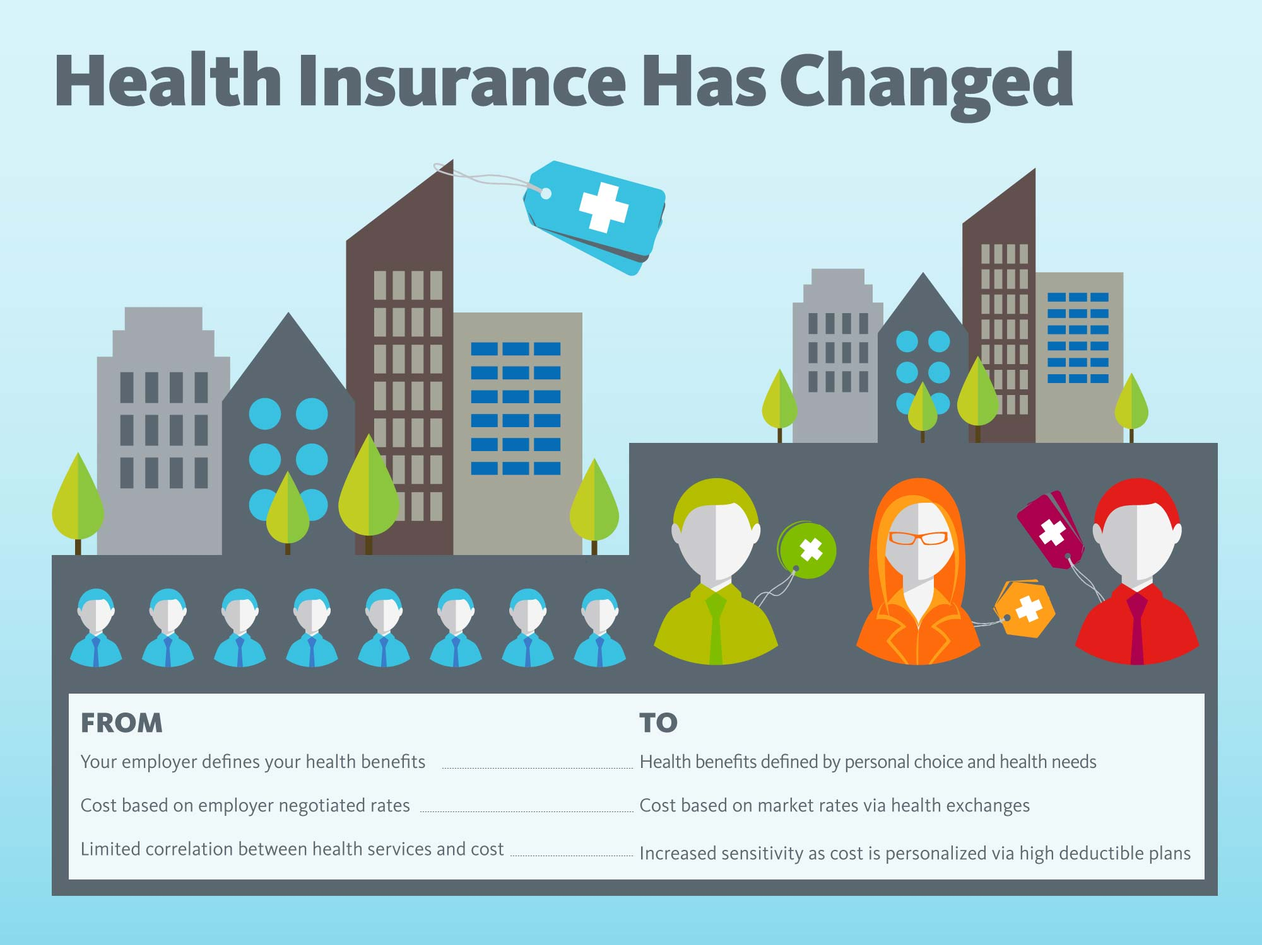

Slide 11
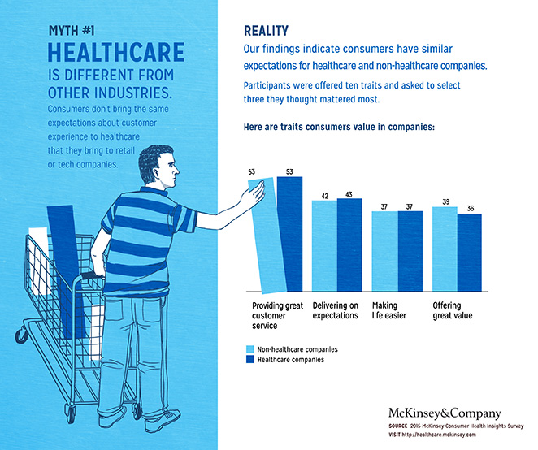

Slide 12
Questions & Discussion

Slide 13
Consumerism and Oral Health

Slide 14
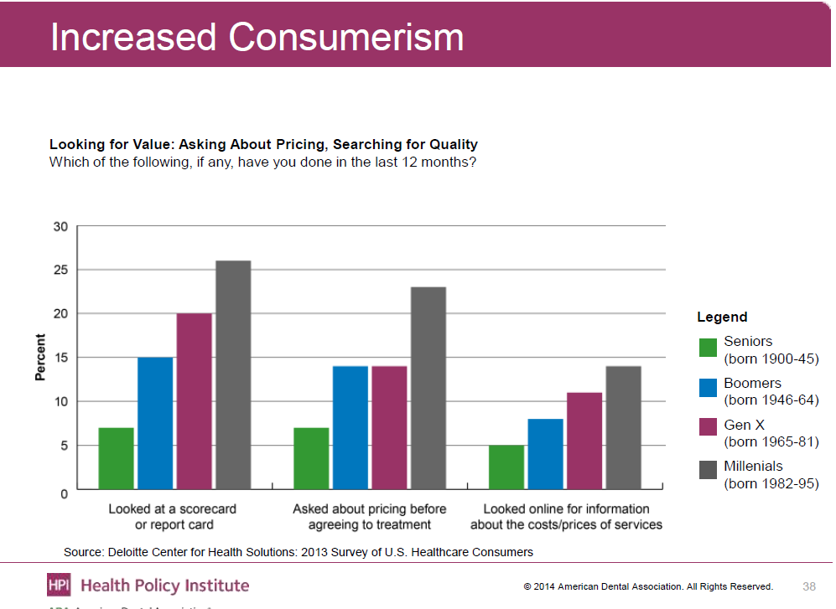
Notes:
Priorities are changing as well
Talk about community partnerships like churches and schools to broaden community impact.
Put in what portion of health is what behavior; 20% influence clinically and up to 40% behavior
Millennials : Due to their frugal nature and financial necessity, they always strive to save time, money, and effort

Slide 15
Media Navigation
The “YELP Era”
In 2010, more than 112,000 individual doctors were reviewed, compared with 2,475 in 2005
23% of 2137 adults surveyed for JAMA use rating sites such as Healthgrades, Vitals, RateMDs, and ZocDoc.
Harvard business school found a one-star drop in a rating can reduce revenue by almost 10%
Notes:
The last thing to ever do is treat this population any different from the general consumer base
So, online reviews are one way

Slide 16
Patient Satisfaction Evaluation Tools
Subjective patient outcomes can be assessed with validated patient surveys
Oral Health Impact Profile (OHIP-14)
These surveys measure a patient’s own perception of the effect of care on their oral health status.
Considered an augmentation to the OHC’s current patient satisfaction review process
need both tools
Can outsource data collection and reporting
Multitude of companies that work with individual institutions to obtain patient experience information
Notes:
These surveys may be given in addition to the Health Center’s patient satisfaction survey, which is usually administered on an annual basis.
Validated surveys lack some information that can impact the business model more than the clinical model and have to be able to understand how the two interact and shift

Slide 17
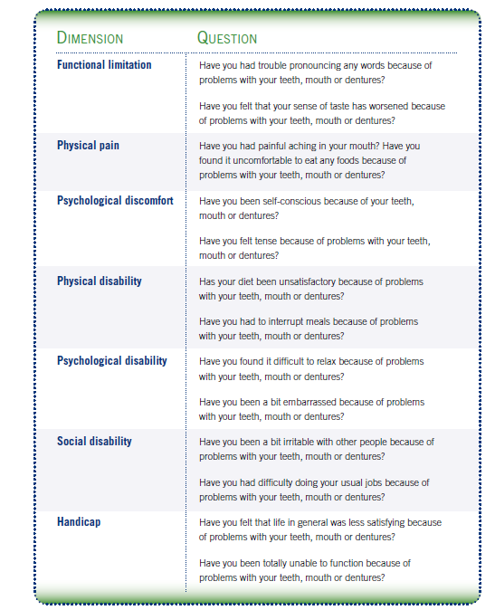
OHIP-14
http://www.nnoha.org/nnoha-content/uploads/2013/08/OpManualChapter6.pdf

Slide 18
Knowing the Quality of Devices Used
“The dental restoration industry’s lack of transparency has been an increasingly troubling issue for the past several years, says the National Association of Dental Laboratories. With the increasing demand for dental implants, NADL encourages consumers to stay informed about the quality of their restorations in order to avoid future health implications.”
“The public needs to be aware that in most states, there is no disclosure of the materials or brands used in their dental restorations, like you would find in the surgical medical device industry.”
https://www.e-dental.com/doc/growing-dental-implant-industry-needs-transparency-0001

Slide 19
Safety Concerns – Sterilization and Disease
Infection control-sterilization is often foremost on a patient’s mind and vital to their concept of quality health care
A recent analysis conveyed that parents’ attentiveness to dental office and instrument cleanliness was affected and heightened following news reports of sterilization failures in dentistry.
As practices improve sterilization transparency and accountability, the dental office’s sterilization center has been anecdotally proposed as the “new glove” in dentistry.
The Organization for Safety, Asepsis and Prevention (OSAP).. http://www.osap.org/?Patient_FiveQuestion
Burhenne M.. http://www.cnn.com/2013/03/29/health/dentist-5-things/
Martinez TS, et al. Western University of Health Sciences, 2015.
Amos J. http://howtoopenadentaloffice.com/sterilization-center/

Slide 20
Improving the Sterilization Process
In the current dental care market, dentists are feeling pressure to improve production while safeguarding the integral safety of the patient.
Fortunately, innovation with dental processing equipment provides today’s dental care teams with avenues to safer methods, “…while realizing efficiencies and ultimately, saving money.”
Use of instrument cassettes
Ultrasonic cleaner
Water filtration system and auto fill
On-site sterilization indicators – testing
Use of documents and checklists
Team centered approach

Slide 21
Consumer Involvement
Previous investigations have analyzed service elements for which higher expectation was placed.
Notably, the highest score awarded by patients surveyed was “clean and hygienic appearance” and “thorough sterilization of instruments”,
Which most patients in the presented study regarded as crucial attributes. .
Dental office tour (On line and on site)
Display of sterilization equipment testing and type used
Have a team shared vision for safety by the dental care teams.
Notes:
Include information on online reviews and Harvard Business review financial impact

Slide 22
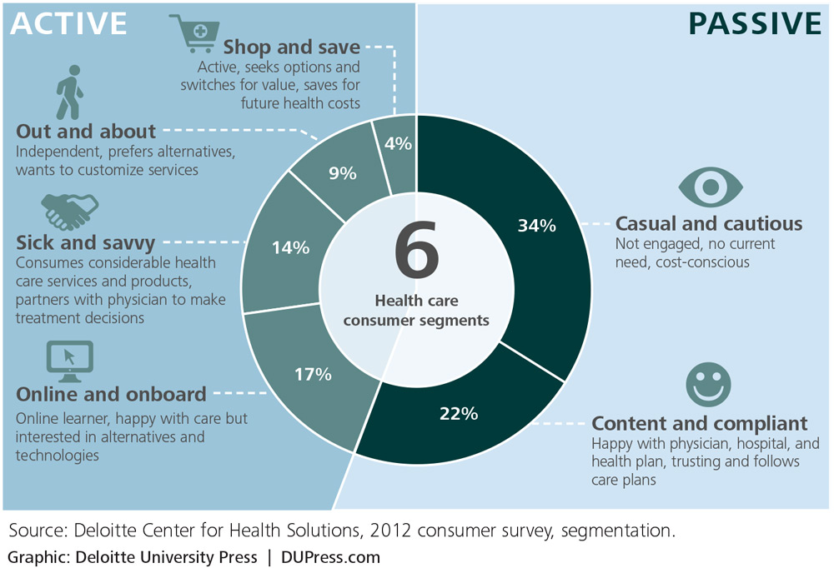
Every person in the U.S. healthcare system wears a number of hats: they’re shoppers, insurance policy holders, payers, patients, and maybe even medical savers or investors. But at the heart, they’re consumers

Slide 23
Questions & Discussion

Slide 24
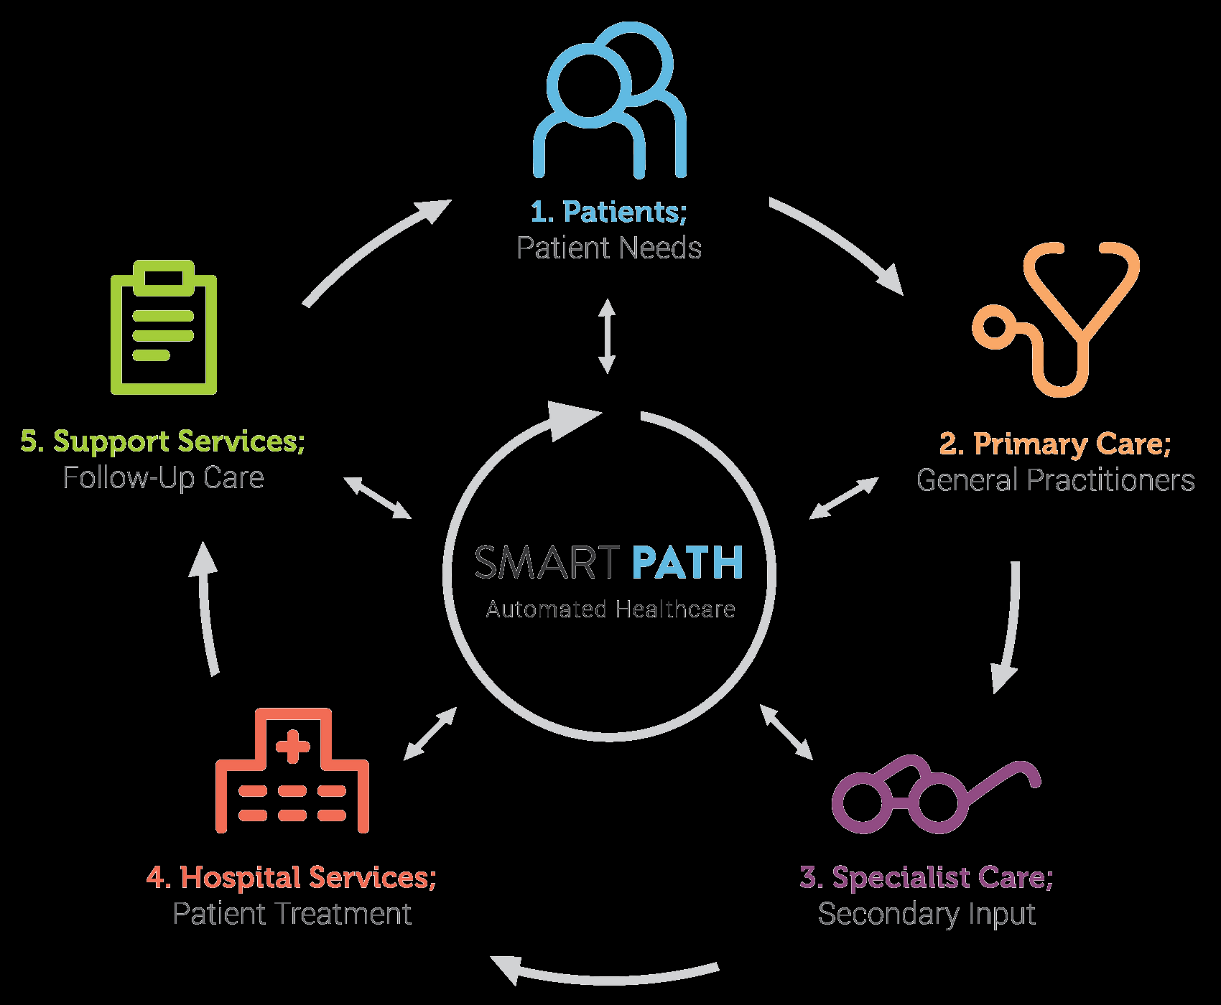
Navigating the Care Pathway

Slide 25
Patient Navigation and Coordinating Care
Patient navigation may be defined as the process of helping patients to effectively and efficiently use the health care system.
4 major challenges patients face when navigating health care’s complex system:
choosing, understanding, and using health coverage or applying for assistance when uninsured;
choosing, using, and understanding different types of health providers and services;
making treatment decisions;
managing care received by multiple providers.
Sofaer S. Med Care Res Rev 2009; 66(1 Suppl): 75S–93S.

Slide 26
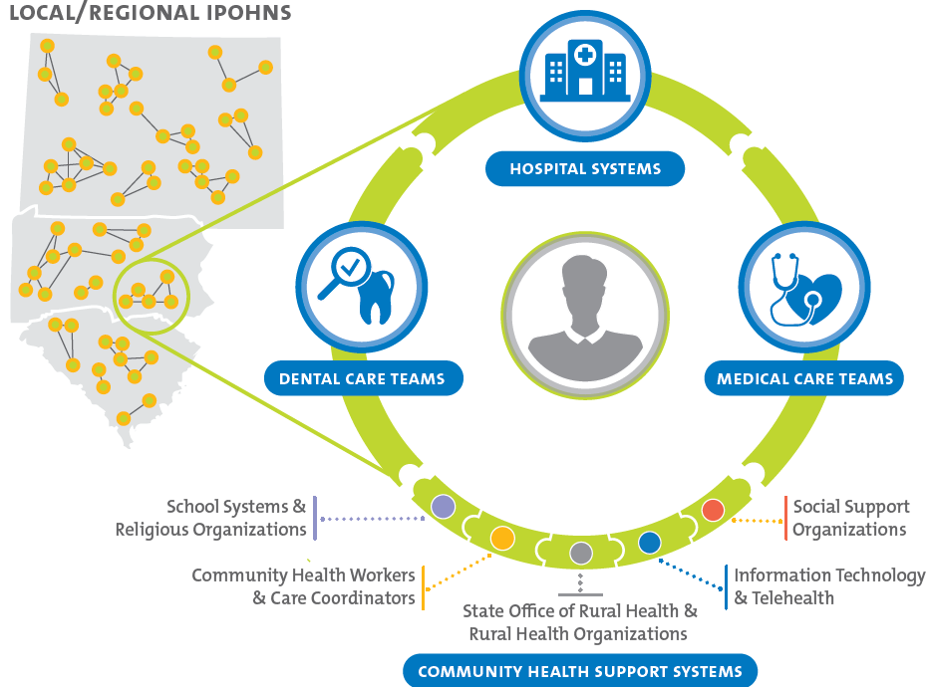

Slide 27
Pathway construction and expansion
Developing or adding to a pathway involves evaluating efficacy, tolerability, and cost — in that order.
If more than one approach is equally effective, the most tolerable wins out (in oncology, best tolerated invariably means least toxic), and if two or more options are equally tolerable, the less costly one wins.
Pathways must be supported by scientific evidence and national guidelines
Carlson B. Biotechnology Healthcare, 2009;6(1), 23–26

Slide 28
Roles & Responsibilities w/ the Care Pathway
Although practices are often expected to assist patients in meeting these challenges, the majority of practices cannot assume this role effectively because of perceived time, personnel, and reimbursement constraints.
Usually personnel assigned to these tasks
Extremely rare in dental care
Traditionally focus on high-risk, high-cost patients who have a single disease (eg, diabetes or asthma) to ensure they receive services they need.
Stille CJ et al. Ann Intern Med 2005; 142: 700–8.
Ferrante et al. 2010; 23:736-42

Slide 29
Patient Navigation – Perceived Value
Patients gained information and services that they would not otherwise have received, and they appreciated having someone call to check on them and provide information, support, and guidance.
Some patients and family members reported feeling fortunate to receive this service and that having a PN service made them appreciate the office more.
As one such patient reported, “It made me feel like they were a more caring, thoughtful office, somebody that I would want to continue to see on a regular basis because they had this extra help for their patients.”
A few mentioned that speaking with the navigator made them feel better especially with regard to psychological distress.
As one stated, “I'm going through a lot of depression…and when I speak to her I feel much better.”
Stille CJ et al. Ann Intern Med 2005; 142: 700–8.
Ferrante et al. 2010; 23:736-42

Slide 30
Questions & Discussion

Slide 31
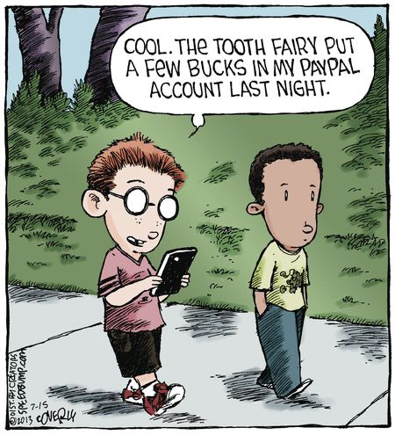
Use of Service and Patient Preference

Slide 32
Notes:
So this is how they make decisions of care but what is important to how they flow through this

Slide 33
What do patients want?
They want dentists to take their insurance
59% of our survey respondents say that their decision to patronize a practice hinges on insurance
42% of patients say they would switch dentists if their current practice stopped accepting their plan.
Notes:
Disease management often referred to as the “medical model”
Areas of overlap between population health designs.
Interprofessional care

Slide 34
What do patients want?
They want convenience
Notes:
2Patients Want You
To Be Convenient
The second most important factor patients consider when selecting a dentist is
location. 44% of survey respondents said that a convenient office is a must.
While younger patients (ages 25-34) are more willing to put up with an
office that is out-of-the-way than older patients (ages 35-54), nearly
half of all patients won’t patronize practices that fall outside the
radius of their daily travels between home, work, school, etc.

Slide 35
What do patients want?
To read and evaluate reviews

Slide 36
What do patients want?
Technology for care, communication, and education
Many patients between the ages of 25 and 54 said that they would switch from their current dentist if they did not offer advanced technology treatment options.
It’s important to distinguish your practice as the tech conscious, comfort-conscious office when speaking with patients. Be sure to mention the advantages of your practice’s technological capabilities during new patient phone calls, office tours and during treatment.
Notes:
Just have wifi

Slide 37
What do patients want?
Family and friends endorsement or recommendations
While much has changed in the dental profession over the past 20 years, one thing has remained constant:
The importance of word-of-mouth referrals.
84% of the patients solicit personal recommendations from family, friends and co-workers when they search for a new dentist.
This is up from 74% in 2013.

Slide 38
Word of Mouth
Word of mouth is the primary factor behind up to 50% of all purchase decisions.
Customers referred by other customers have a 37% higher retention rate.
People are 4 times more likely to remain a customer when referred by a friend.
Referred customers are 25% more profitable.
McKinsey Quarterly, “A new way to measure word-of-mouth marketing,” April 2010
Forbes, “8 Essentials Of Creating A Sustainable Advocacy Program,” September 17, 2013
Nielsen, “Under the Influence: Consumer Trust in Advertising,” September, 17, 2013
Marketing Intelligence Review, “Do Referral Programs Increase Profits? Case Study / Vol. 5,” November 1, 2013

Slide 39
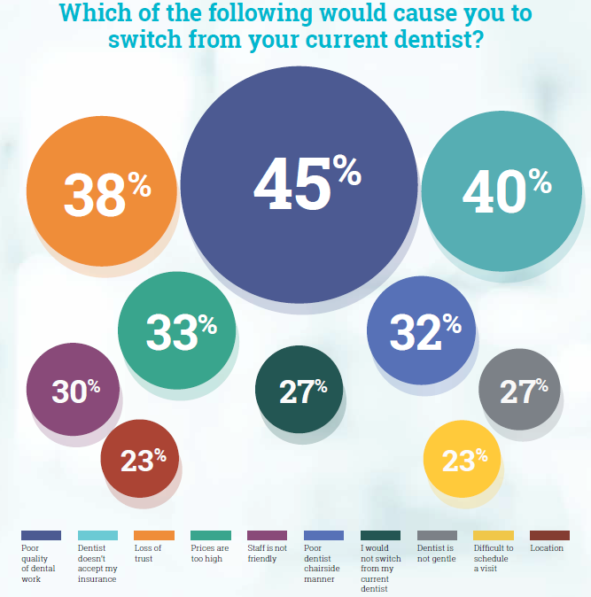

Slide 40
Questions & Discussion

